Slide 1
Deployement Machine Learning with Flask and Heroku
Pr. Mohamed OUZARF
@FST
University Sidi Mohamed Ben Abdellah
Fes Morocco
April: 2019 @Uminho

Slide 2
Data Analytic Methods
found APIs from Amazon, Microsoft, and Google that did all the machine learning: training modeling and deployement
to use machine learning without megacorporations wich anyone can do it. The current libraries we have in Python are amazing.I will try explain how we can use these libraries to create a proper machine learning back end.

Slide 3
Outline & Content
What is Flask?
Why Flask?
Getting started

Slide 4
What is is Flask ?
Flask is a microframework based on PYTHON
http://flask.pocoo.org/

Slide 5
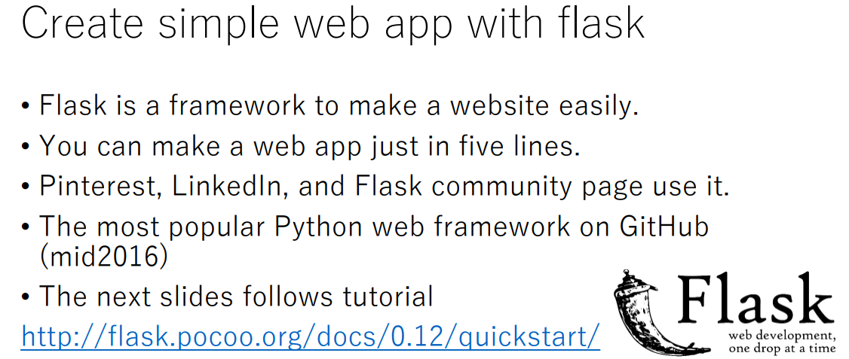

Slide 6
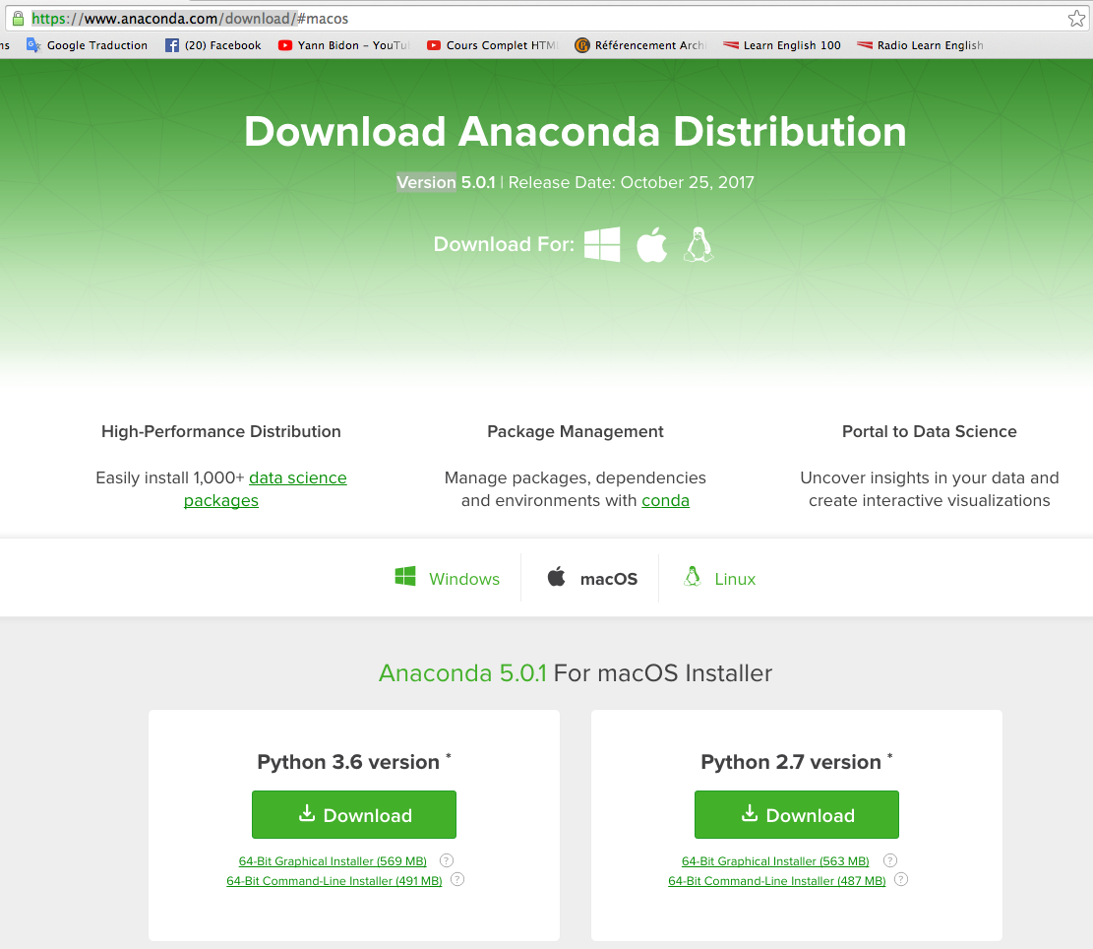
Exploratory Data Analytic Using Python
Tools and Creating the Work Environement
Downloading, Installing and Starting Python and Libraries
First you will need to have Python installed. It is probably already installed on your system. https://www.python.org/
1.1 There are 5 key libraries that you will need to install.
scipy
numpy
pandas
sklearn
matplotlib
seaborn
1.2 I would recommend installing the free version of Anaconda that includes everything you need.

Slide 7
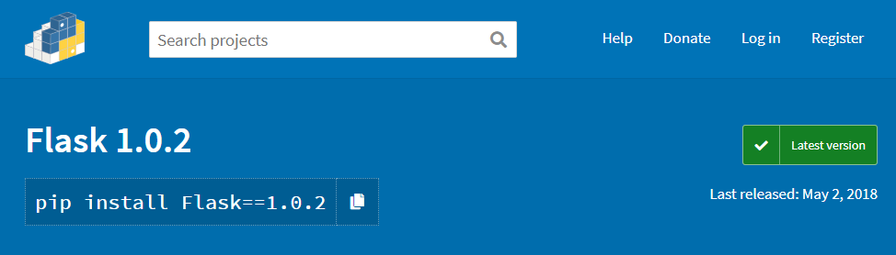
Flask install
https://pypi.org/project/Flask/1.0.2/

Slide 8
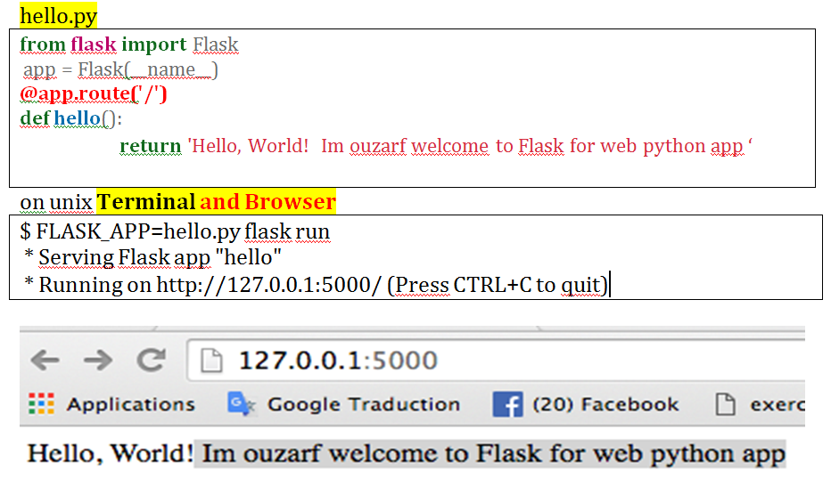
flask run on Terminal

Slide 9
Training and deploying machine learning models
Training a model
Importing and exporting Python model
Creating a simple web server
Adding the model to the server

Slide 10
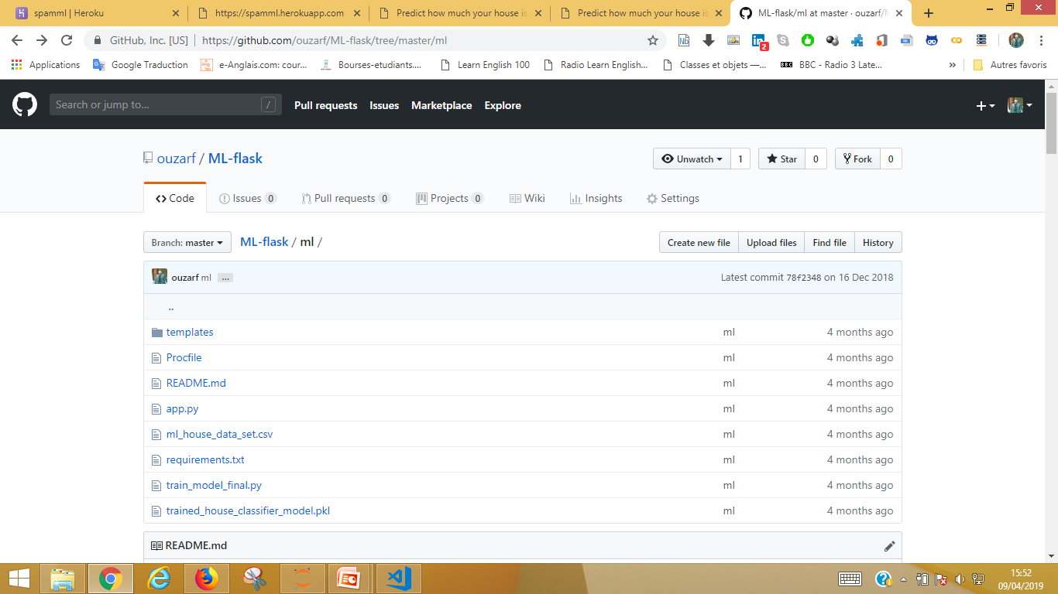

Slide 11
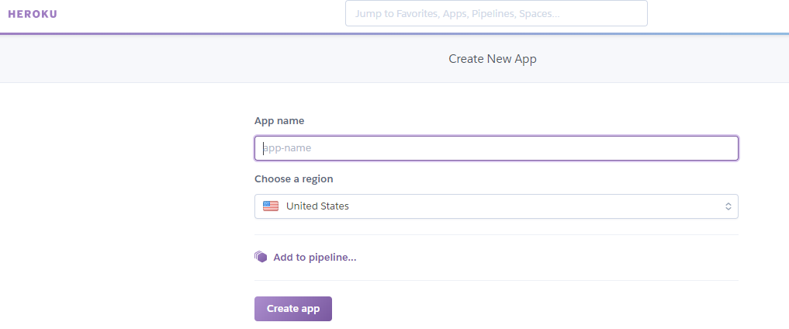
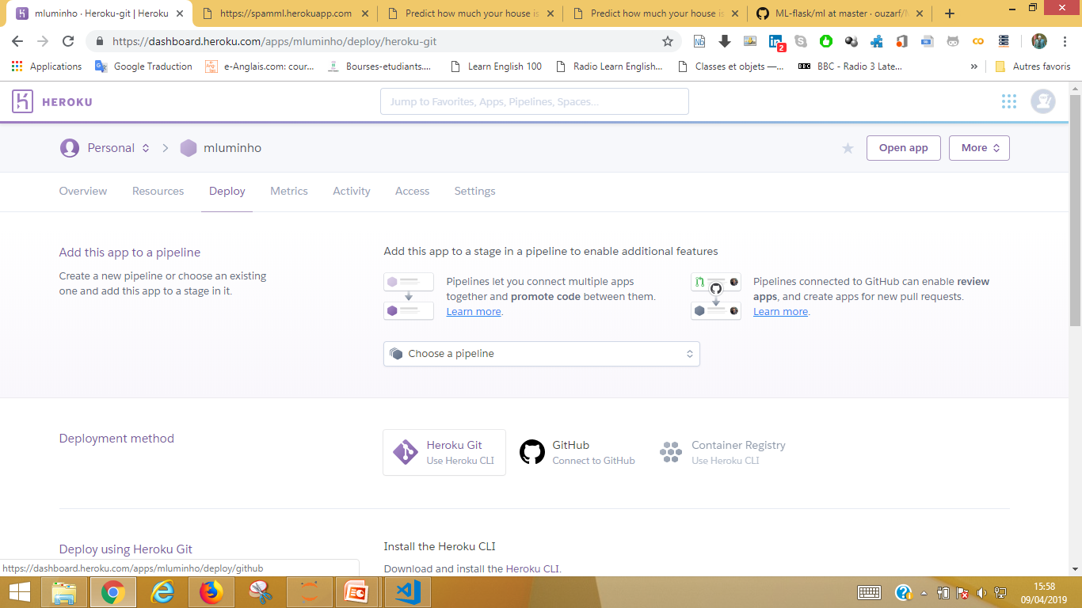
DEPLOYEMENT
1
2

Slide 12
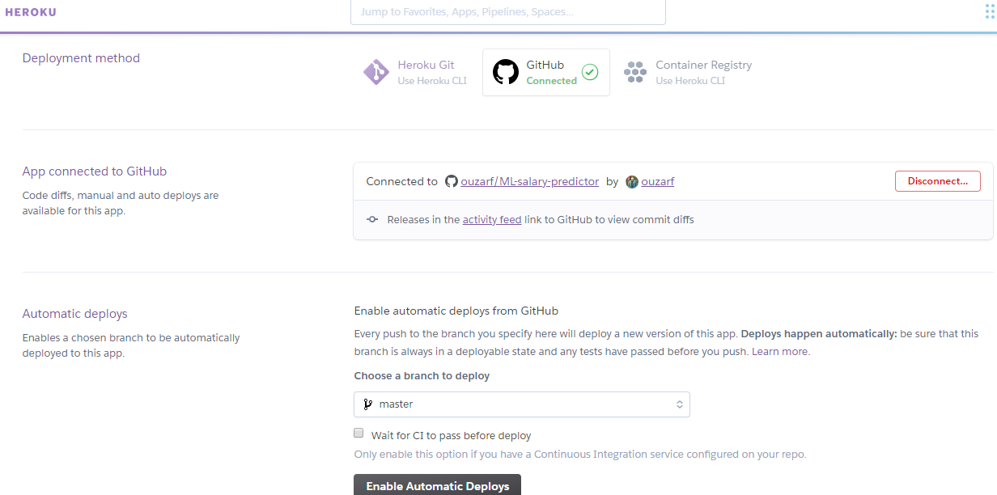
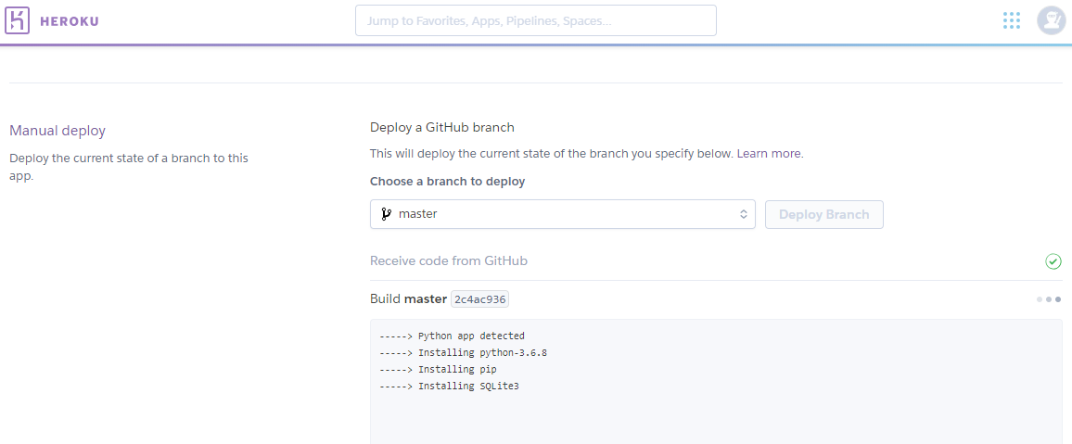
3
4

Slide 13
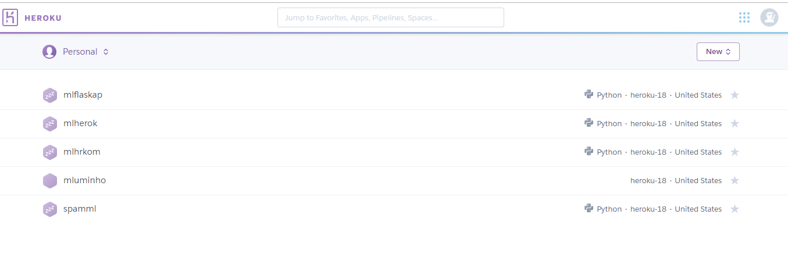
5
https://mlhrkom.herokuapp.com/

Slide 14
DEMO
https://github.com/ouzarf/
local
C:\Users\Mohamed\1Uminho\Folder1-tutorial\flask-ml-master>python app.py
Via : command line
or
Visua studio code
server
https://mlhrkom.herokuapp.com/

Slide 15
THANK YOU

